Slide 1

18CSC302J- Computer Networks
Unit-3
School of Computing - SRMIST Kattankulathur Campus

Slide 2
Syllabus
DNS- DNS in the Internet, DNS Resolution, DNS Messages
TELNET – SSH
FTP- TFTP
WWW Architecture, Documents
HTTP, HTTP Request and Reply,
DHCP Operation, DHCP Configuration
SMTP, POP3, IMAP, MIME
Learning Resources
Douglas E. Comer, Internetworking with TCP/IP, Principles, protocols, and architecture,Vol 1 5th Edition,2006 ISBN: 0131876716, ISBN: 978-0131876712

Slide 3
DNS(Domain Name System)
TCP/IP protocols uses IP address.
Identifies connection of a host to the internet.
System maps a name to an address
Host file – only two columns (name, address)
Single host file – maps the names to address
Host file would be large to store in every host.
Impossible to update the changes happens every time to the host file.
Solution 1
Store the host file in a single system and allow the centralized information access to every system that needs mapping.
Disadvantage
Huge amount of traffic to the internet.
Solution 2
Divide the huge amount of information into smaller parts and store on different systems.
Host which needs mapping can communicate to the closest system that holds the information.
This solution is called Domain Name System.
18CSC302J- School of Computing (Odd sem 2020)

Slide 4
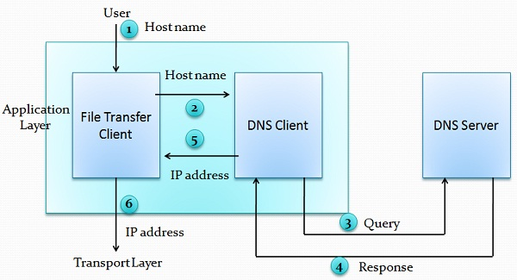
Purpose of DNS
Six steps to map host name to an IP address
User passes the host name to the file transfer client (FTC).
FTC passes the host name to DNS client.
DNS client sends a message to the DNS Server. The query gives the file transfer server name using the known IP address of the DNS server.
DNS server responses back with the IP address of the desired file transfer server.
DNS client passes the IP address to file transfer server.
FTC uses the IP address it received to access the file transfer server.
Two Connections must be made
Mapping the name to an IP address
Transferring files

Slide 5
Namespace
Maps the address to the unique names.
Organized in two ways flat or hierarchical.
Flat Name Space
Name is assigned to an address, name is the sequence of characters without structures.
Disadvantage
Cannot used in large system.
Centrally controlled to avoid ambiguity and duplications.
Hierarchical Name Space
Each name is made up of several parts.
First part – nature of organization
Second part – name of an organization
Third part – departments in the organization
Namespace can be decentralized.
Suffixes (or prefixes) are added to the name that defines the host or system.

Slide 6
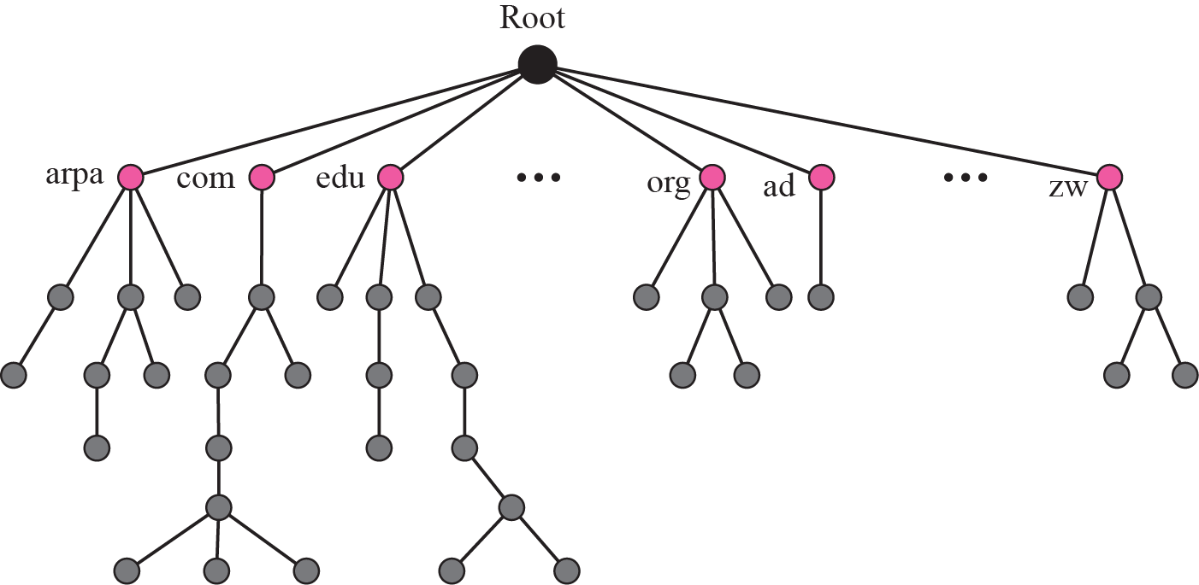
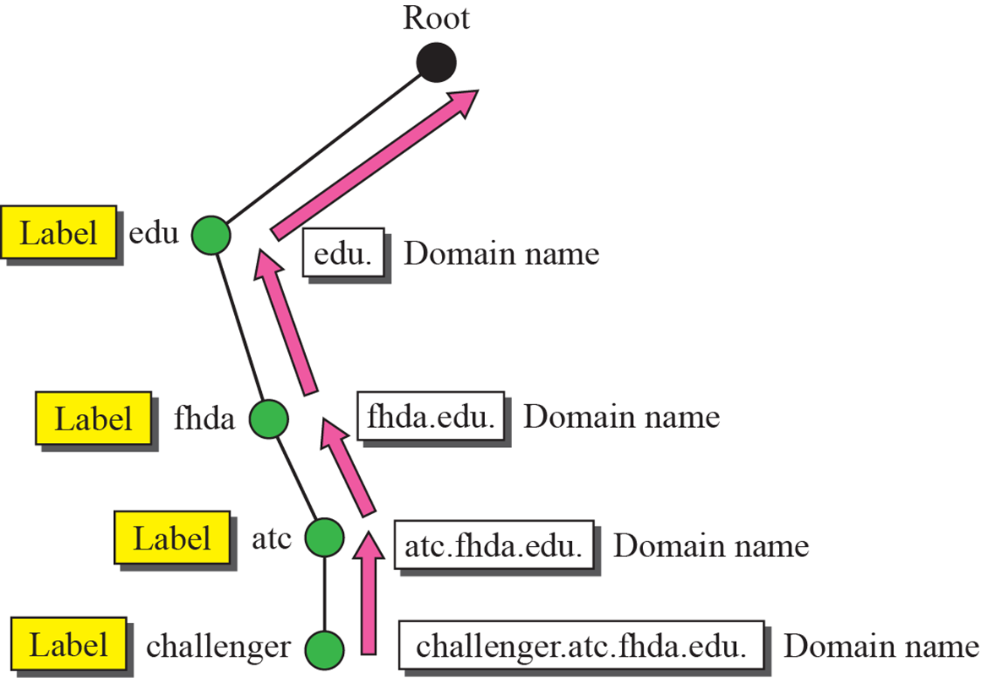
Domain Name Space
Hierarchical name space – DNS was designed.
Names are defined in inverted tree structure with root at top.
Tree have 128 levels – 0 (root) to 127.
Label
Each node in a tree has a label – max of 63 characters.
Root label is a null string.
Children node should have different labels that will ensure uniqueness in domain names.
Domain Name
Full domain name is the sequence of labels separated by dots.
Domain names read from nodes up to the root.
Full domain name always ends in a null label.
Domain Name System
Domain names and labels

Slide 7
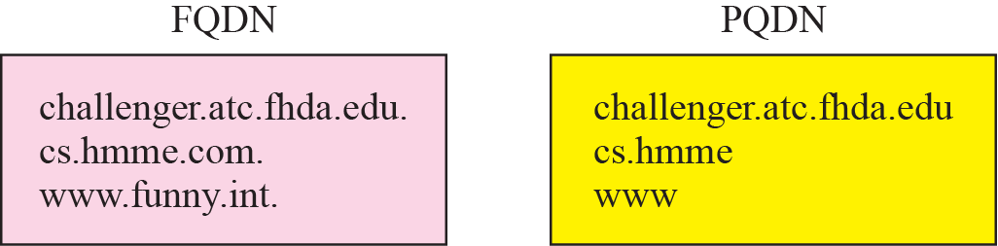
Fully Qualified Domain Names (FQDN) Partially Qualified Domain Names (PQDN)
Fully Qualified Domain Names (FQDN)
If the label is terminated by null string it is called fully qualified domain names.
Contains the full name of the host, contains all labels from most specific to most general.
DNS server can match an FQDN to an address.
Eg: challenger.atc.srmuniv.edu.
Partially Qualified Domain Names (PQDN)
If the label is not terminated by null string it is called partially qualified domain name.
PQDN starts from the node but does not reach the root.
The resolver will supply the missing part called the suffix to create a PQDN.
User at fhda.edu site wants to get the IP address of the challenger computer, has to mention the partial name.
Eg: challenger
The DNS client adds the suffix before parsing the address to the DNS server.
Eg: atc.srmuniv.edu
FQDN and PQDN

Slide 8
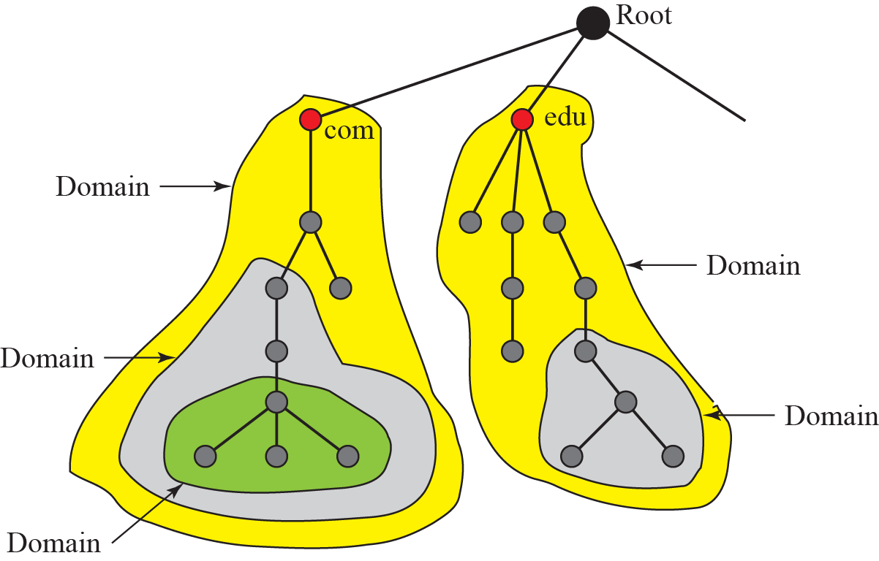
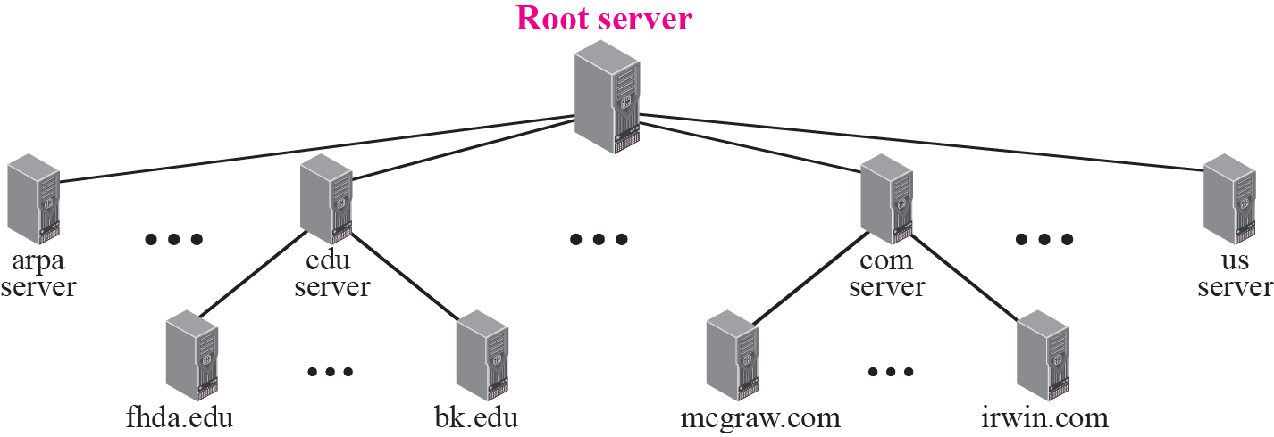
Domain Name Space
Domain
It is the subtree of domain name space.
The domain is the name of the node at the top of the subtree.
Domains may itself divided into sub domains.
Distribution of name space
Information in the name space must be stored.
It is inefficient and not reliable to store the information in a single system.
Solution
Distribute the information among many computers called DNS servers.
Hierarchy of name space
Divide the whole space into many domains based on the first level.
Domains
Hierarchy of name servers

Slide 9
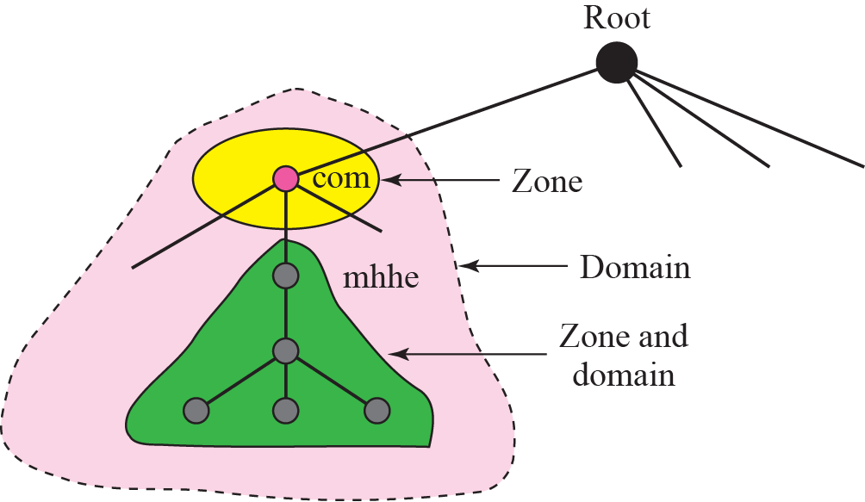
Domain Name Space
Zone
What a server is responsible for or has authority over is called zones.
Zone is the contiguous part of the entire tree.
If server accepts the responsibility for a domain and does not divide the domain into smaller domains then “domain” and “zone” refers the same thing.
Root server
It is the server whose zone consists of the whole tree.
It does not store any information about the domains but delegates the authority to other servers, keeping references to those servers.
Zones and Domains

Slide 10
Domain Name Space
Primary and Secondary Servers
Primary Server
Server that stores the file about the zone for which it is in authority.
It is responsible for creating, maintaining and updating the zone files.
It stores zone file on a local disk.
Secondary Servers
Server that transfers the complete information about zone from another server and stores the file on its local disk.
Secondary server neither creates nor updates the zone files.

Slide 11
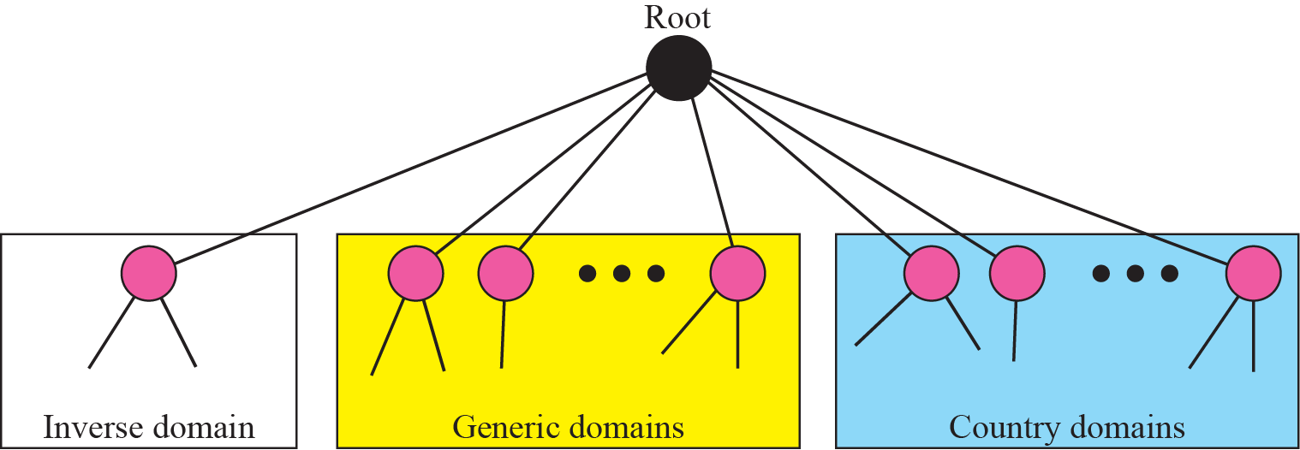
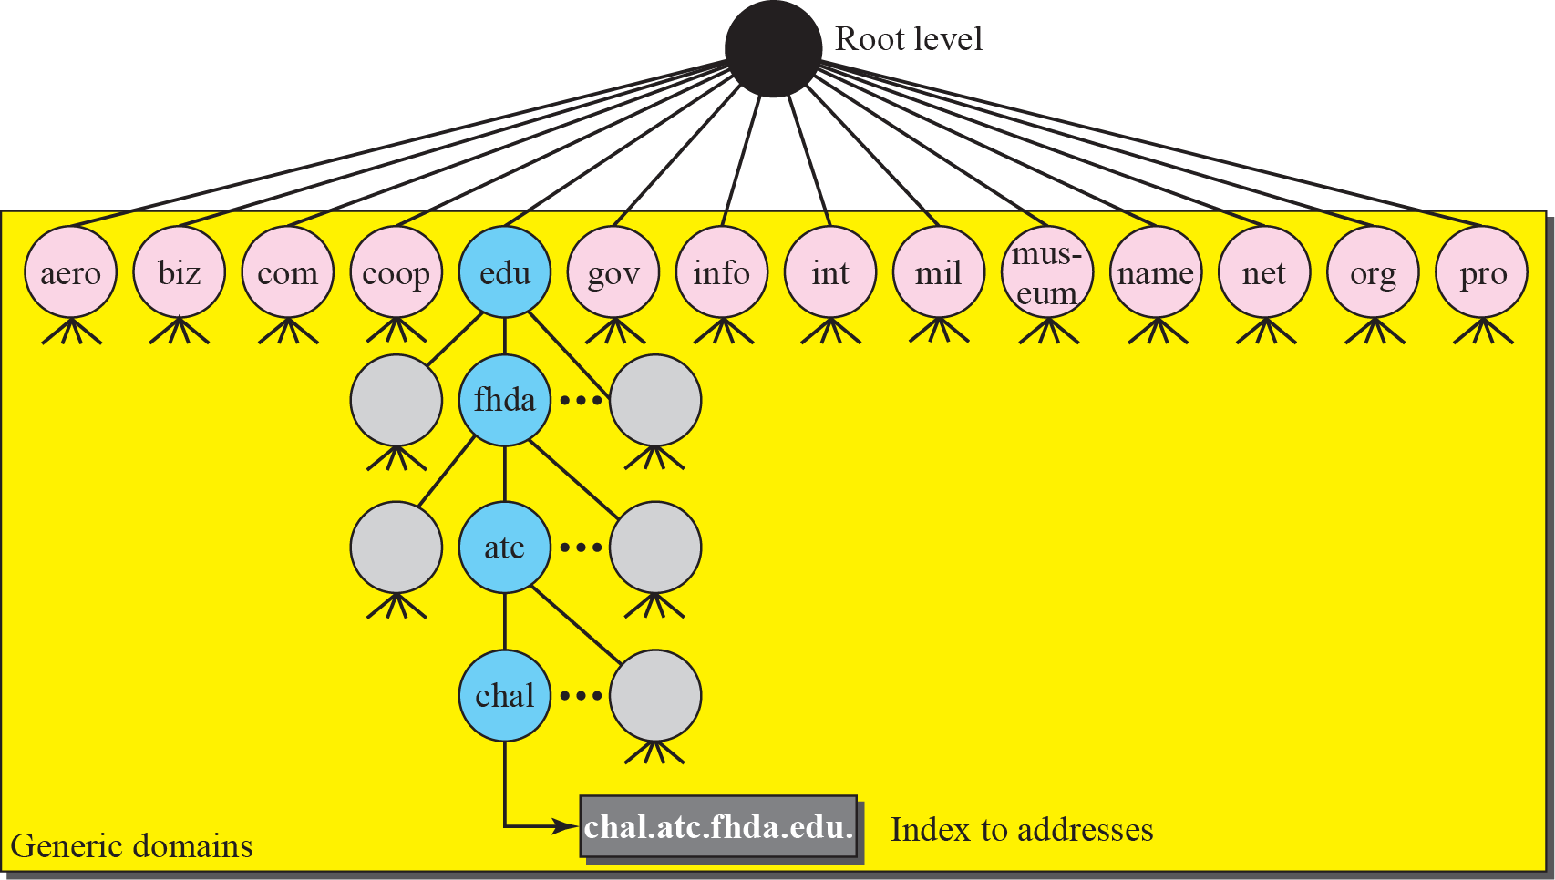
DNS in the Internet
In internet the domain name space is divided into three different sections.
Generic domains, country domains and the inverse domains.
Generic Domains
Define registered hosts according to their generic behaviour.
Each node in a tree defines a domain which s an index to the domain name space database.
DNS used in internet
Generic Domain Labels
Generic Domains

Slide 12
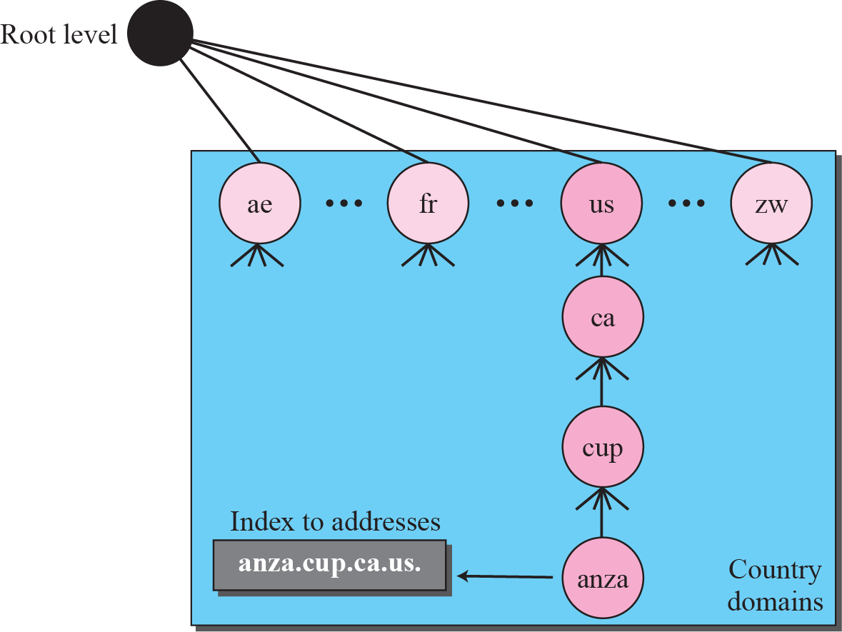
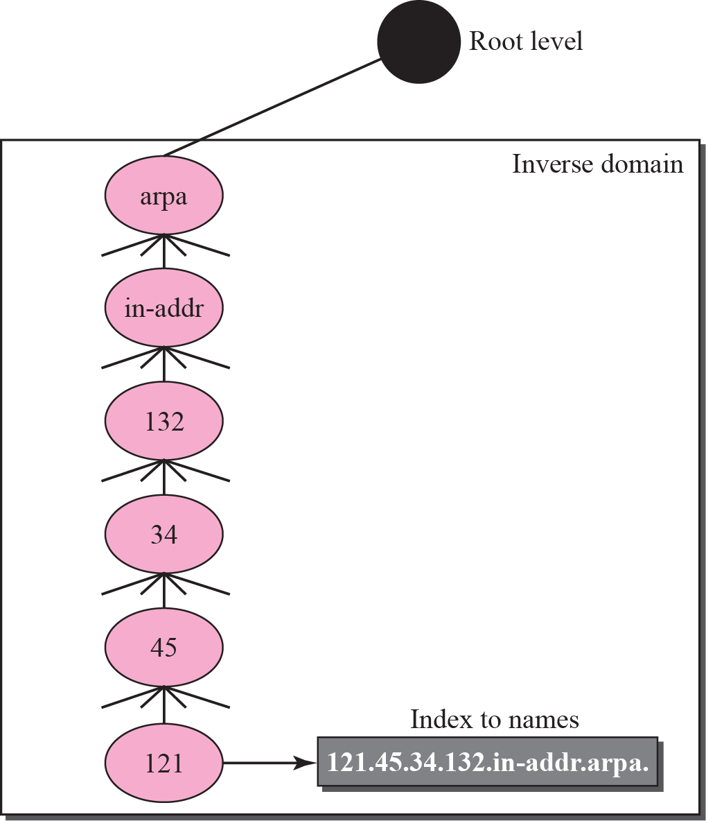
DNS in the Internet
Country Domains
Uses two character country abbreviations.
Eg: US for United Sates
Second label can be organizational or they can be more specific national designations.
Eg: ca.us
Inverse Domain
It is used to map an address to a name.
This happens when the server has received a request from the client.
Type of query called an inverse or pointer (PTR) query.
To handle the pointer query the inverse domain is added to the domain name space with the first level node.
Second level is also one single node named in addr (for inverse address).
Country Domains
Inverse Domain

Slide 13
Resolution
Mapping a name to an address or an address to a name is called name address resolution.
Resolver
DNS is designed as a client – server application.
Host that needs to map an address to a name or a name to an address calls a DNS client called a resolver.
After the resolver receives the mapping, it interprets the response to see if it is a real resolution or an error and finally delivers the results to the process that requested it.
Mapping Names to Addresses
The resolver gives a domain name to the server and asks for the corresponding address.
If the domain name is from the generic domain the resolver receives a domain name such as “chal.atc.fhda.edu.
if the domain name is from the country domain the resolver receives a domain name such as “ch.fhda.cu.ca.us.

Slide 14
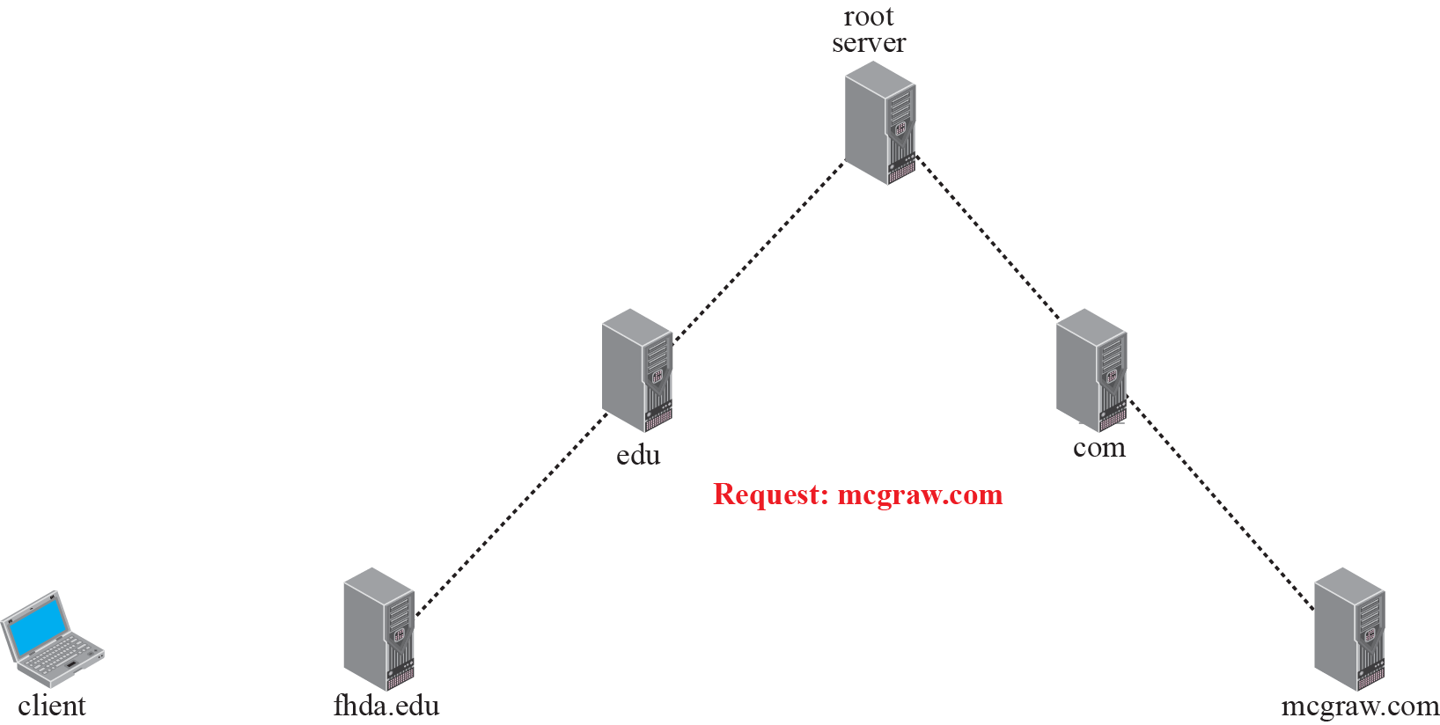
Resolution
Mapping Addresses to Names
A client can send an IP address to a server to be mapped to a domain name.
To answer the PTR query DNS uses the inverse domain.
in the request the IP address is reversed and two labels in-addr and arpa are appended to create a domain acceptable by the inverse domain.
Recursive Resolution
The client can ask for a recursive answer from a name server.
If the server is the authority for the domain name, it checks its database and responds.
If the server is not the authority it sends the request to another server and waits for the response.
If the parent is the authority it responds otherwise it sends the query to another server.
Recursive resolution

Slide 15
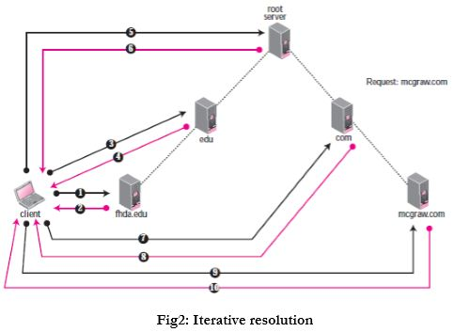
Resolution
Iterative Resolution
If server is an authority for the name it sends the answer.
If not it returns the IP address of the server that thinks it can resolve the query.
The client is responsible for repeating the request to the second server.
The client repeats the same procedure to next server and so on
This process is called iterative because the client repeats the same query to multiple servers.
Catching
Each time the server receives the query for a name that is not in domain it needs to search its database for a server IP address.
Reduction in search time would increase the efficiency.
DNS handles this with the mechanism called catching.
Iterative Resolution

Slide 16
Resolution
Reduction of search time would increase the efficiency.
DNS handles this with the mechanism called catching.
Catching speeds up resolution but it can also be problematic.
If the server catches the mapping for a long time it may send an outdated mapping to the client.
Two counter techniques are used
The authoritative server always adds information to the mapping called time to live.
DNS requires each server keep a TTL counter for each mapping it caches.

Slide 17
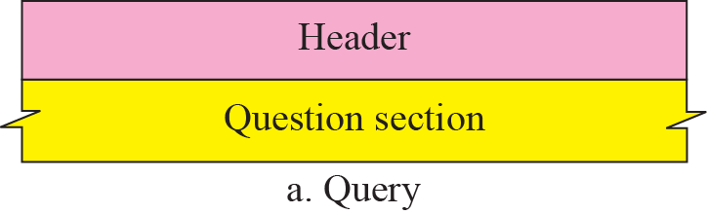
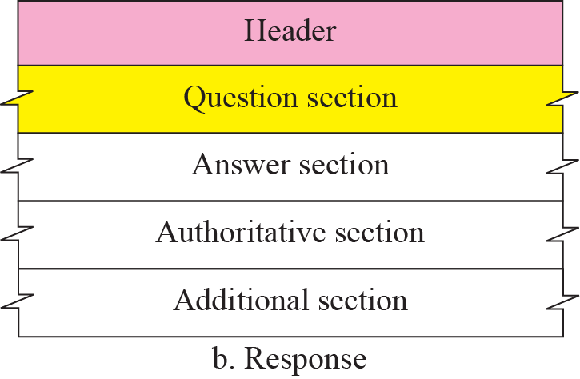
DNS Messages
DNS messages are of two types
Query
Response
The query message consists of header and question records.
The response message consists of header, question records, answer records, authoritative records and additional records.
Query and Response Messages

Slide 18
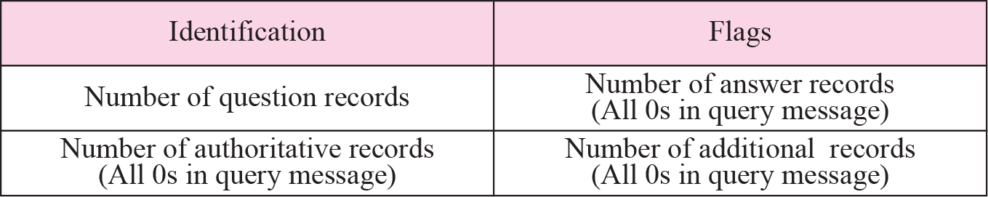
DNS Messages
Header
Both query and response message have the same header format with some fields set to zero for query messages.
The header is of 12 bytes.
Identification - 16 bit field used by client to match the response with the query.
Flags – 16 bit field consisting of the subfields.
QR (Query/Response) – 1 bit sub field defines type of message.
0 – message is query
1 – message is response
OpCode - 4 bits, defines the type of query or response
0 – standard
1 – inverse
2 – server status request
Header Format
Flags Field

Slide 19
DNS Messages
AA (Authoritative Answer) – 1 bit subfield
Set to 1 - name server is the authoritative server
Used only in response message.
TC (Truncate) – 1 bit subfield
Set to 1 – response was more than 512 bytes and truncated
It is used when DNS uses the services of UDP
RD (Recursion Desired) – 1 bit subfield
Set to 1 – client desires a recursive answer
It is set in query message and repeated in the response message
RA (Recursion Available) – 1 bit subfield
Set in response, means that a recursive response is available
Set only in response message
Flags Field

Slide 20
DNS Messages
Reserved – 3 bit sub field set to 000.
rcode – 4 bit field shows status of error in response
Only authoritative server can make the judgement
Number of question records – 16 bit field
Contains the number of queries in question section of the message
Number of answer records – 16 bit field
Contains the number of answer records in answer section of the response message
Number of authoritative records – 16 bit field
Contains number of authoritative records in authoritative section of the response message
It’s value is zero in query message
Number of additional records – 16 bit field
Contains number of additional records in additional section of a response message
Flags Field
Values of rcode

Slide 21
DNS Messages
Question Section
Consists of one or more question records
It is present in both query and response messages
Answer Section
Consists of two or more resource records
It is present only on response messages
Authoritative Section
Consists of two or more resource records
It is present only on response messages
Gives information (domain name) about one or more authoritative servers for the query
Additional Information Section
Consists of two or more resource records
It is present only on response messages
Gives additional information that helps the resolver

Slide 22
WWW Architecture

Slide 23
WWW Architecture
WWW is a networked information system (repository of information) and it provides distributed client-server service, in which a client using a browser can access a service using a server.
Sites
Web pages (simple / composite)
Client
Request
Server
Response

Slide 24
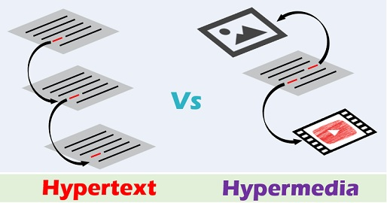
Hypertext and Hypermedia
Hypertext –creating a document that in turn refer to other document. In a hypertext document, a part of text can be defined as a link to another document.
Hypermedia is a term applied to document that contains links to other textual document or documents containing graphics, video, or audio.

Slide 25
Web Client (Browser)
It is an application software that allows us to view and explore information on the web. User can request for any web page by just entering a URL into address bar.
Web browser can show text, audio, video, animation and more. It is the responsibility of a web browser to interpret text and commands contained in the web page.
A variety of vendors offer commercial browsers that interpret and display a Web document, and all of them use nearly the same architecture. Each browser usually consists of three parts:
a controller – receives input from keyboard
client protocol – access the document
Interpreters – display document on screen

Slide 26
Web Server
Web site is collection of web pages while web server is a software that respond to the request for web resources.
When client sends request for a web page, the web server search for the requested page if requested page is found then it will send it to client with an HTTP response.
If the requested web page is not found, web server will the send an HTTP response : Error 404 Not found.
A server can also become more efficient through multithreading or multiprocessing. In this case, a server can answer more than one request at a time.
Some popular Web servers include Apache and Microsoft Internet Information Server.

Slide 27
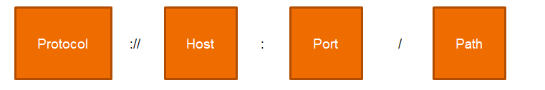
Uniform Resource Locator (URL)
A URL (Uniform Resource Locator) is a unique identifier used to locate a resource on the internet.
Protocol - client-server application program used to retrieve the document (http)
Host - domain name of the computer on which the information is located (www)
Port – (optional) If the port is included, it is inserted between the host and the path, and it is separated from the host by a colon.
Path - pathname of the file where the information is located.

Slide 28

Web Documents

Slide 29
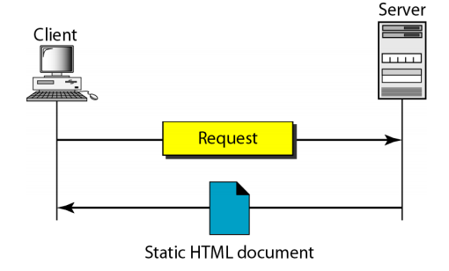
Static Documents
The author of a static document determines the contents at the time the document is written.
Since the contents do not change, each request for a static document results in exactly the same response.
Static documents are prepared using – HTML, XML, XSL, XHTML.

Slide 30
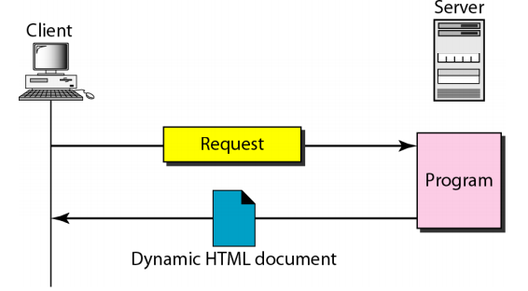
Dynamic Documents
A dynamic web document does not exist in a predefined form.
When a request arrives the web server runs an application program that creates the document.
The server returns the output of the program as a response to the browser that requested the document.
Since a fresh document is created for each request, the contents of a dynamic document can vary from one request to another.
Technologies involved – PHP, JSP, ASP etc.
Dynamic documents are sometimes referred to as server-site dynamic documents.

Slide 31
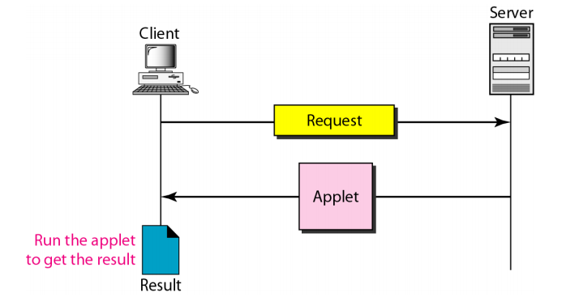
Active Documents
An active web document consists of a computer program that the server sends to the browser and that the browser must run locally.
When it runs, the active document program can interact with the user and change the display continuously.
Active documents are sometimes referred to as client-site dynamic documents.

Slide 32
HTTP

Slide 33
HTTP
The Hypertext Transfer Protocol (HTTP) is a protocol used mainly to access data on the World Wide Web.
HTTP functions as a combination of FTP and SMTP.
HTTP uses the services of TCP on well-known port 80.

Slide 34
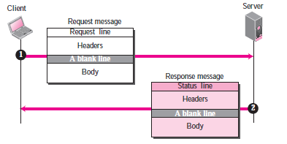
HTTP Transaction
The Hypertext Transfer Protocol (HTTP) is a protocol used mainly to access data on the World Wide Web.
HTTP functions as a combination of FTP and SMTP.
HTTP uses the services of TCP on well-known port 80.
Request message
Request Line

Slide 35
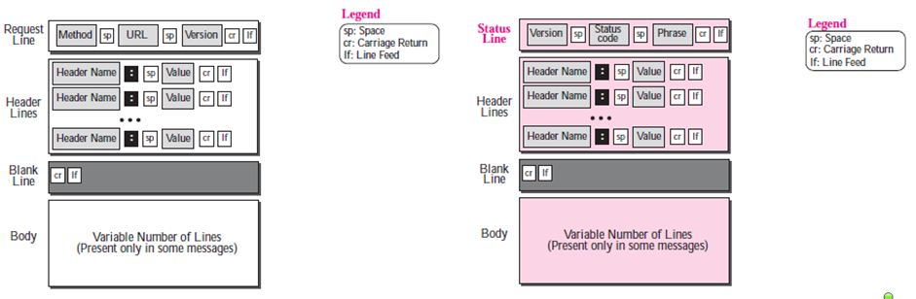
HTTP Transaction (Cont . . .)
Format of request message and response message

Slide 36
Conditional Request
Request based on condition is possible.
If condition is met, server sends it; else client is informed about it.
Example conditions - time and date the Web page is modified.
Request
GET http://www.commonServer.com/information/file1 HTTP/1.1
If-Modified-Since: Thu, Sept 04 00:00:00 GMT
Response
HTTP/1.1 304 Not Modified
Date: Sat, Sept 06 08 16:22:46 GMT
Server: commonServer.com
(Empty Body)

Slide 37
Persistence
HTTP version 1.1 specifies a persistent connection by default.
Connection is left open for more requests.
Connection will be closed only after a request or if a time-out is reached.
Length of data is sent by the sender on each response, but if it is unknown (Dynamic documents) then the server informs client and closes the connection.

Slide 38
Cookies
It is a small piece of data stored in users system by the browser while browsing a website.
When the client receives the response from server on request, the browser stores the cookie in the cookie directory.
Next time, when a client sends a request to a server, the browser looks in the cookie directory to
see if it can find a cookie sent by that server. If found, the cookie is included in the request.
Example – e-commerce

Slide 39
Web caching: Proxy server
Proxy server acts as a gateway between client and server.
It keeps copies of responses to recent requests.
On receiving the request from client, proxy server checks its cache and if it is not found then the request is sent to corresponding server.
This reduces the load on the original server, decreases traffic, and improves latency.
However, to use the proxy server, the client must be configured to access the proxy instead of the target server.

Slide 40
HTTP security
HTTPS provides confidentiality, client and server authentication, and data integrity.

Slide 41
DHCP

Slide 42
Introduction
Every computer that utilizes TCP/IP protocol should know its IP address.
In addition to this, Subnet mask is also needed, if the computer is under a subnet.
The other two information needed for most of the recent machines are
The default router’s address – to interface with other networks
The name server’s address – to use names rather than addresses.

Slide 43
DHCP (Definition)
It is a Client/server protocol to provide the four required parameters to a diskless machine to enable the machine communicate with other networks.

Slide 44
DHCP Operation
The operation is initiated with a broadcasting request by the client depending upon the client and server’s location, which could be any one of the following
Same network - Client and server are present on the same network
Different network - Client and server are present on different network

Slide 45
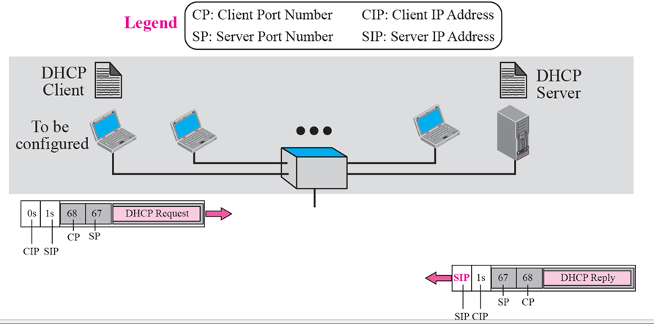
Same Network

Slide 46
Same network Operation
A open command is provided by the server on UDP port number 67.
Server waits for the client to respond
The server gets the response from the booted client on port number 68
A connection is now established between the source port 67 and destination port 68 by the server acknowledging with either a broadcast or unicast message.

Slide 47
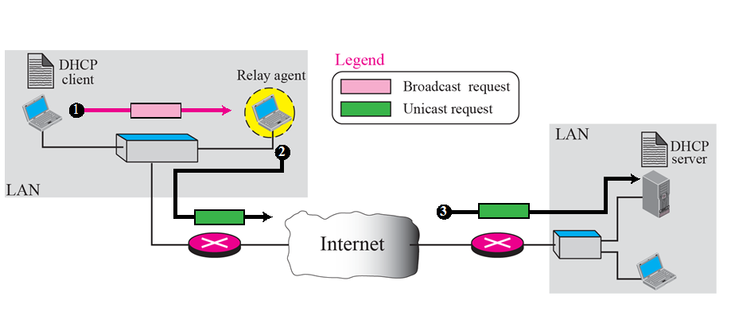
Different network

Slide 48
Different network Operation
As the client is unaware of the server, a DHCP request is broadcasted.
A relay agent (host) is used, as the router discards the broadcasted IP datagram.
This relay agent is aware of the server’s address and hence listens on UDP port 67 for the messages
The received message is enfold in a unicast datagram (with the destination address) and sent to the server by the relay.
It reaches the server through any router

Slide 49
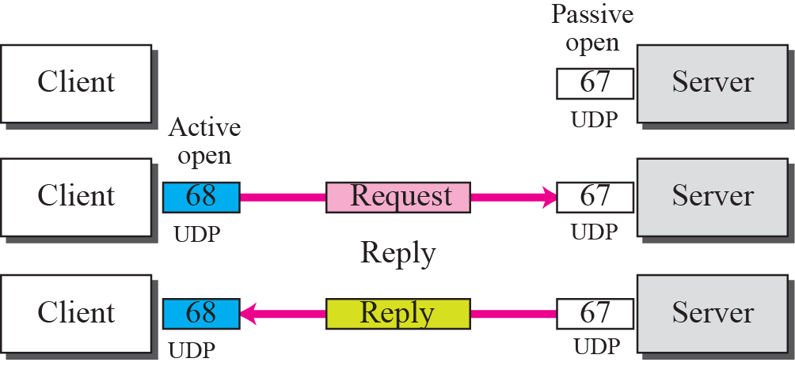
UDP ports

Slide 50
UDP Ports
Port 67 - used by server (Common)
Port 68 - used by client (to overcome the demultiplexing issue)
Consider the below scenario
Host A uses DHCP client
Host B uses DAYTIME client
(both are in the same network and uses ephermal port 2017)
A broadcast message is sent from the server as an acknowledgement

Slide 51
UDP ports (Contd..)
This message contains the destination port 2017 and broadcast IP address FFFFFFFF16
Host A finds a message from application program on 2017
A correct message and incorrect message is delivered to DHCP and DAYTIME clients respectively
Transaction ID is also used to identify the clients which avoids the confusion created.

Slide 52
TFTP
It is an acknowledgement from the server, containing the pathname of a file which has the complete booting information.

Slide 53
Error control
To take a control over the lost or damaged response, DHCP requires
Checksum
Retransmission
To prevent traffic jam (Created by retransmission)
Random numbers for timers are used

Slide 54
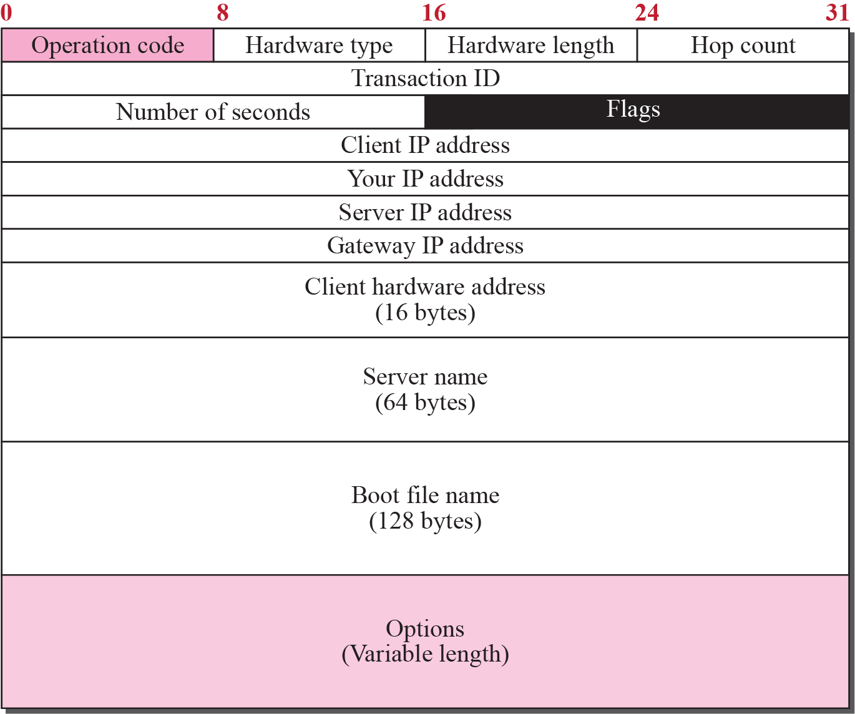
Packet Format

Slide 55
Packet Format (Contd..)
Operation code (8 bit) – Variant of DHCP
Hardware type (8 bit) - variant of physical network
Hardware length (8 bit) - length of physical address in bytes
Hop count (8 bit) - Maximum number of hops
Transaction ID (4 byte) - To match a reply with the request

Slide 56
Packet Format (Contd..)
Number of seconds (16 bit) – Time elapsed to boot the client
Flag (16 bit) – left-most bit is used leaving the remaining bits to be zero.
Client IP address (4 byte) – holds client’s IP address
Server IP address (4 byte) - holds server’s IP address

Slide 57
Packet Format (Contd..)
Gateway IP address (4 byte) – holds router’s IP address
Client Hardware address – Client’s physical address
Server name (64 byte) – holds server’s domain name
Boot file name (128 byte) – Holds path name
Options (64 byte) – carries either vendor information or other additional information.

Slide 58
CONFIGURATION

Slide 59
Static address allocation
A database is used to match physical address to IP address.
DHCP is backward compatible in this case

Slide 60
Dynamic address allocation
An additional database containing the unused IP addresses.
On request from a client, an IP address (temporary ) from this database is allocated to the requesting client on lease.
This is based on the entry in the static database.
This allocation is essential when there is a transfer of host from one network to another.

Slide 61
Transition states
To enable dynamic address allocation, the machine passes through several transitions
The type of the transition is indicated tag 53.

Slide 62
States
INIT state – Client initiates by sending DHCPDISCOVER message
SELECTING STATE – SERVERS offers DHCPOFFER message. Client has to select one among the offers. Client sends DHCPREQUEST message to the selected server.
REQUESTING STATE – Until the client receives DHCPACK message, it stays in the same state

Slide 63
States (Contd..)
BOUND STATE – Client uses the IP address until the lease expires. DHCPREQUEST is again initiated by the client to renew the lease when 50% of the lease period is expired.
RENEWING STATE – If DHCPACK is received, client gets back to BOUND state otherwise enters into the REBINDING state after 87.5% of time expires

Slide 64
States (Contd..)
REBINDING STATE – The client does the following
DHCPNACK / lease expired – Client goes to the initializing state and gets new IP address.
DHCPACK – It goes to the bound state – resets timer.

Slide 65
E - Mail: SMTP, POP, IMAP, and MIME

Slide 66
Discussion On
Architecture
User agent
Message transfer agent
Message access agent
MIME

Slide 67
Architecture
We have 4 scenarios in explain the architecture of e-mail.
First Scenario
Second Scenario
Third Scenario
Fourth Scenario

Slide 68
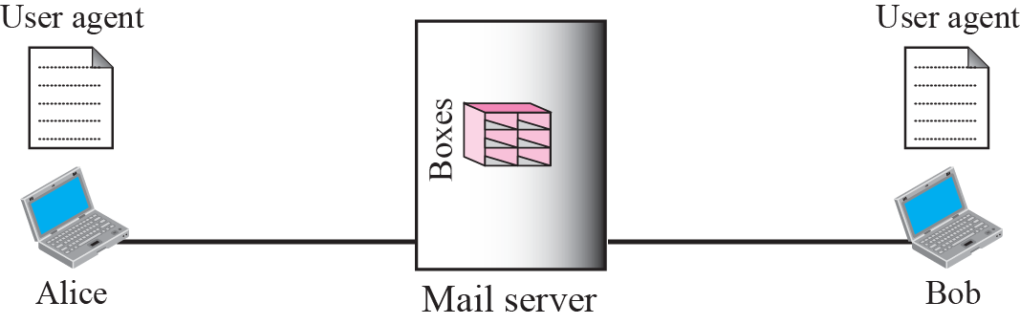
First scenario
The sender and the receiver of the e-mail are users on the same mail server; they are directly connected to a shared mail server.
The admin has created one mailbox to store the received messages. Only the sender or the receiver of the mailbox has access to it.

Slide 69
First scenario(Contd..)
When Alice needs to send a message to Bob, she runs a user agent( is a program) to prepare the message and store it in Bob’s mailbox.
The message has the sender and recipient mailbox addresses. Bob can retrieve and read the contents of his mailbox at his convenience using a user agent.

Slide 70
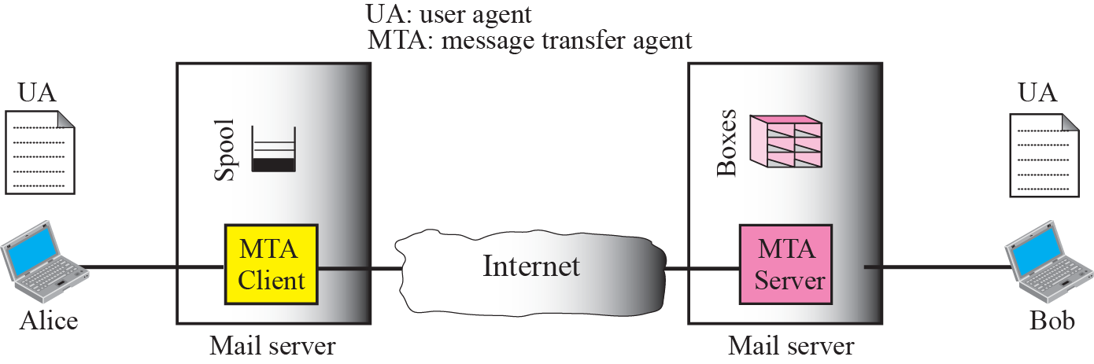
Second scenario

Slide 71
Second scenario (Contd..)
Here, the sender and the receiver of the e-mail are users on two different mail servers. The message needs to be sent over the Internet. Here we need user agents (UAs) and message transfer agents (MTAs)
Alice needs to use a user agent to send her message to the mail server at her own site. The mail server at her site uses a buffer (queue) to store messages waiting to be sent.
Bob also needs a user agent to retrieve messages stored in the mailbox of the system at his site. Here two message transfer agents are needed: one client and one server.
The server needs to run all of the time because it does not know when a client will ask for a connection. The client, on the other hand, can be triggered by the system when there is a message in the queue to be sent.

Slide 72
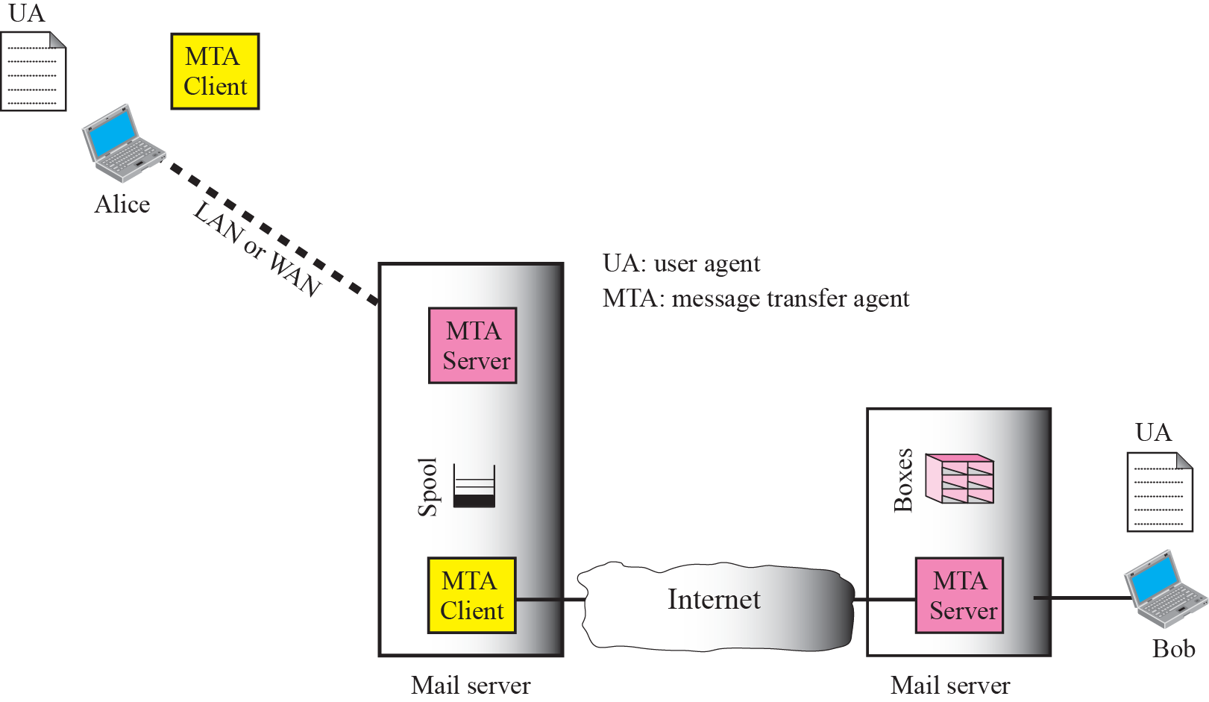
Third scenario

Slide 73
Third scenario (Contd..)
Alice needs a user agent to prepare her message. She then needs to send the message through the LAN or WAN.
This can be done through a pair of message transfer agents (client and server). Whenever Alice has a message to send, she calls the user agent which, in turn, calls the MTA client.
The MTA client establishes a connection with the MTA server on the system, which is running continuously. The system at Alice’s site queues all messages received.
It then uses an MTA client to share the messages to the system at Bob’s site; the system receives the message and stores it in Bob’s mailbox.

Slide 74
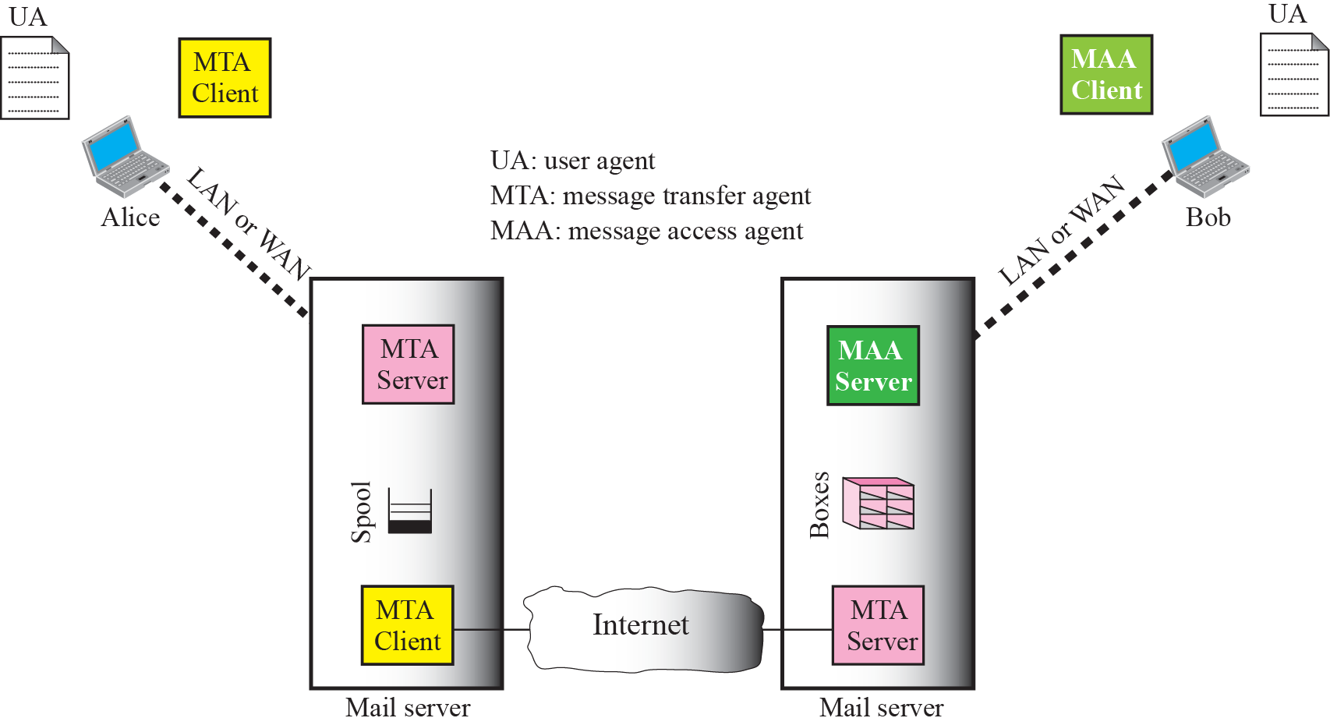

Fourth scenario

Slide 75
Fourth scenario (Contd..)
Here, Bob is also connected to his mail server by a WAN or a LAN. After the message has arrived at Bob’s mail server, Bob needs to retrieve it.
Here, we need another set of client-server agents, which we call message access agents (MAAs).
Bob uses an MAA client to retrieve his messages. The client sends a request to the MAA server, which is running all the time, and requests the transfer of the messages.
Bob cannot bias the mail server to use the MTA server directly. To use the MTA server directly, Bob would need to run the MTA server all the time because he does not know when a message will arrive.

Slide 76
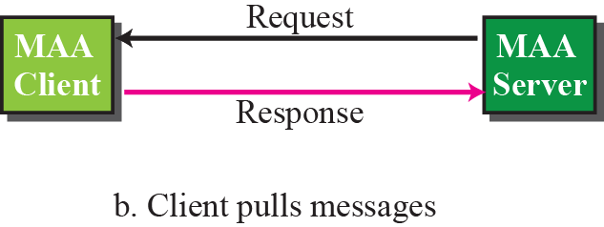
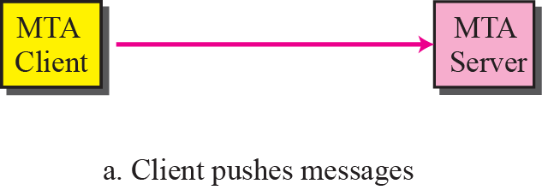
Push vs Pull
Here, Bob needs another pair of client-server programs: message access programs. This is because an MTA client-server program is a push program:
The client pushes the message to the server. Bob needs a pull program. The client needs to pull the message from the server.

Slide 77
User Agent
The first component of an electronic mail system is the user agent (UA). It provides service to the user to make the process of sending and receiving a message easier.
Services Provided by a User Agent
User Agent Types
Sending Mail
Receiving Mail
Addresses
Mailing List or Group List

Slide 78
Message transfer agent
The actual mail transfer is done through message transfer agents (MTAs). To send mail, a system must have the client MTA, and to receive mail, a system must have a server MTA.
The formal protocol that defines the MTA client and server in the Internet is called Simple Mail Transfer Protocol (SMTP).

Slide 79
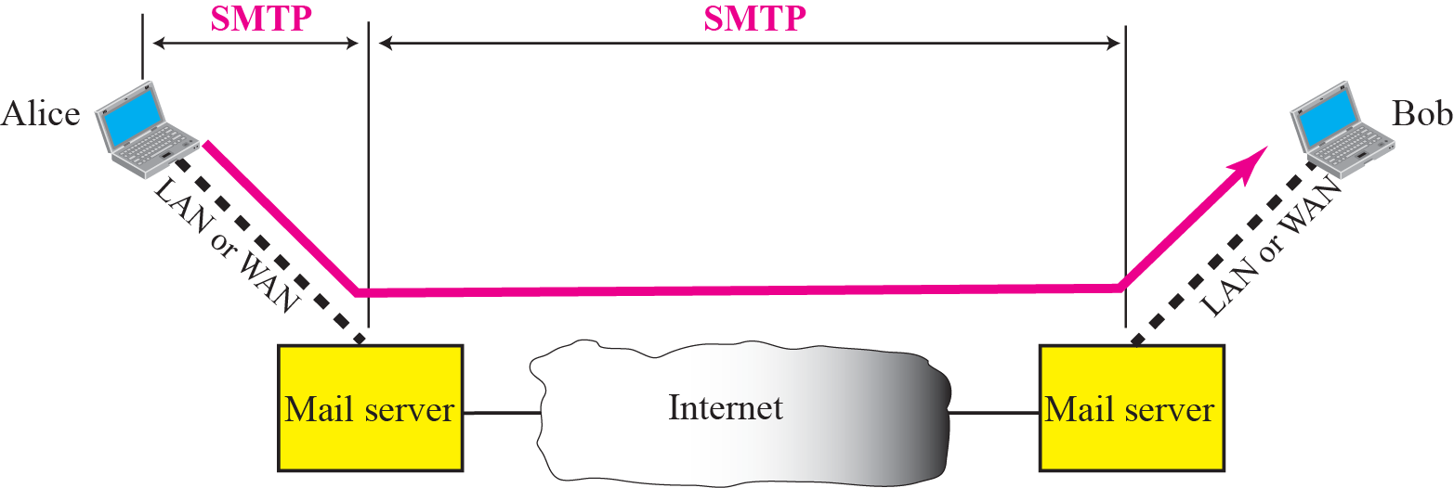
SMTP range

Slide 80
SMTP range (Contd..)
SMTP is used two times, between the sender and the sender’s mail server and between the two mail servers. SMTP defines how commands and responses must be sent back and forth

Slide 81
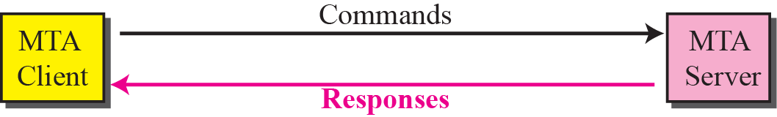
Commands and responses
SMTP uses commands and responses to transfer messages between an MTA client and an MTA server.

Slide 82
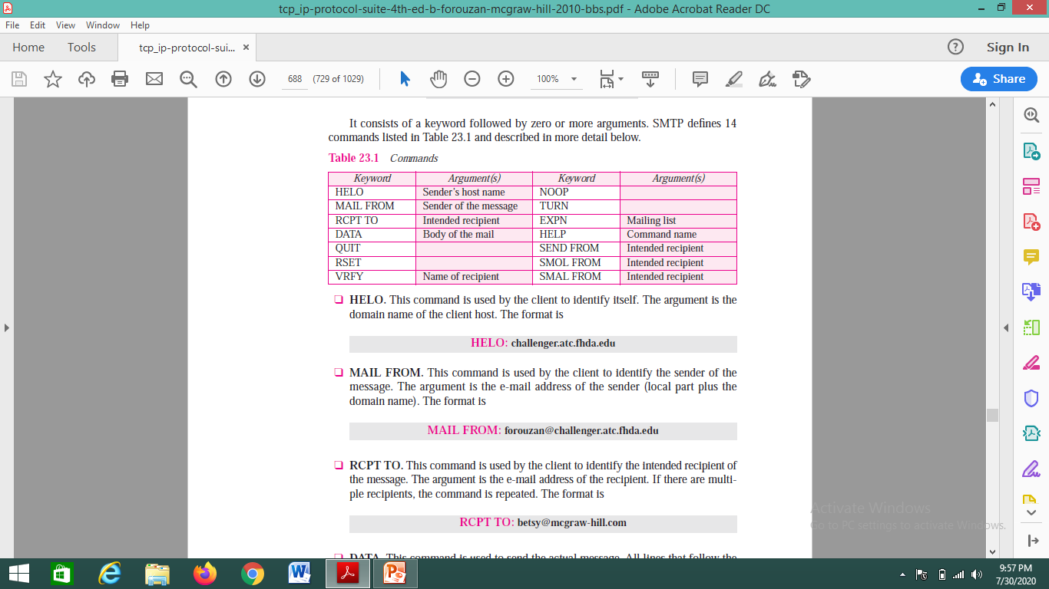
Commands
Commands are sent from the client to the server.

Slide 83
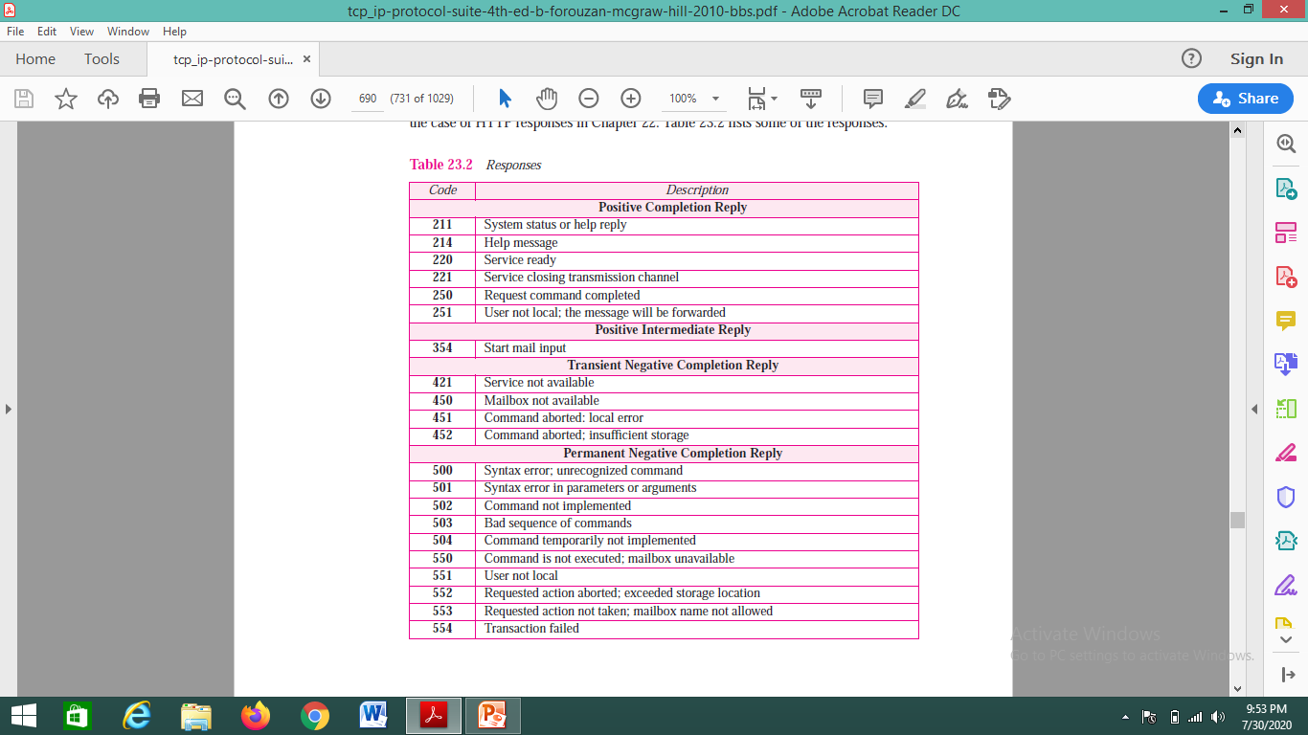
Responses
Responses are sent from the server to the client. A response is a three-digit code that may be followed by additional textual information.

Slide 84
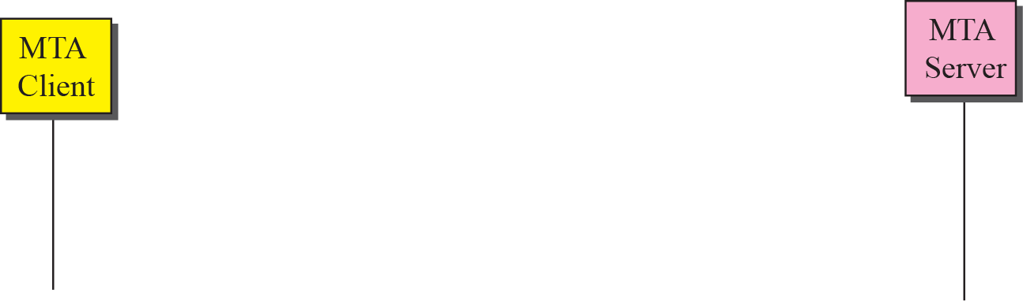
Connection establishment
The server sends code 220 to tell the client that it is ready to receive mail.
The client sends the HELO message to identify itself using its domain name address. This step is necessary to inform the server of the domain name of the client.
The server responds with code 250

Slide 85
Mail Transfer
The client sends the message to introduce the sender of the message. It includes the mail address of the sender. This step is needed to give the server the return mail address for reporting messages.
The server responds with code.
The client sends the message, which includes the mail, that address of the recipient.
The server responds with code.
The client sends the DATA message to initialize the message transfer.
The server responds with code to start mail input.
The client sends the contents of the message in consecutive lines. Each line is terminated by a two-character end-of-line token.
The server responds with code.

Slide 86
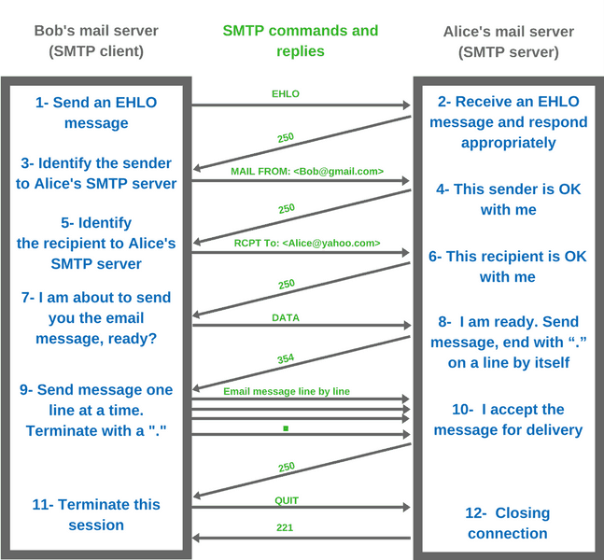
Mail transfer

Slide 87
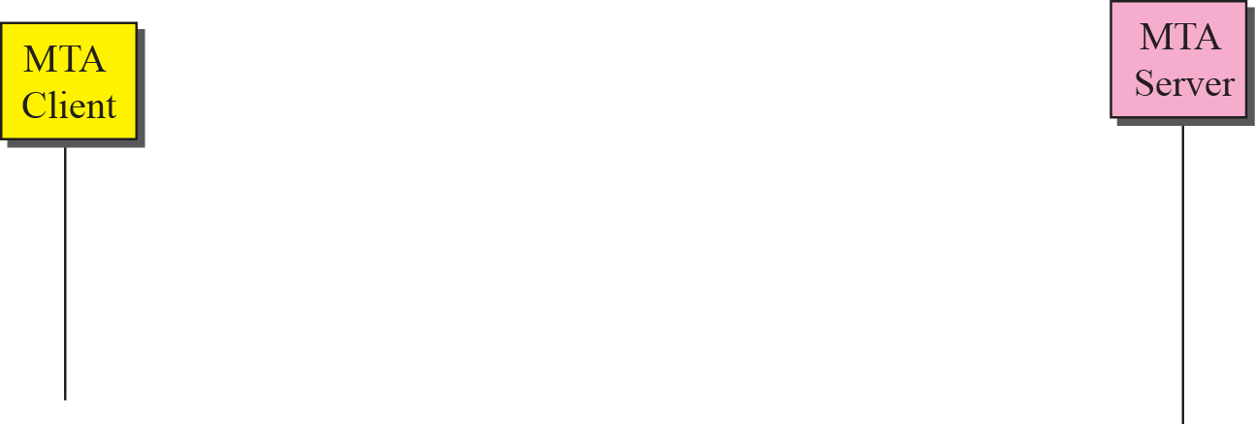
Connection termination
When the message is transferred successfully, the client terminates the connection.

Slide 88
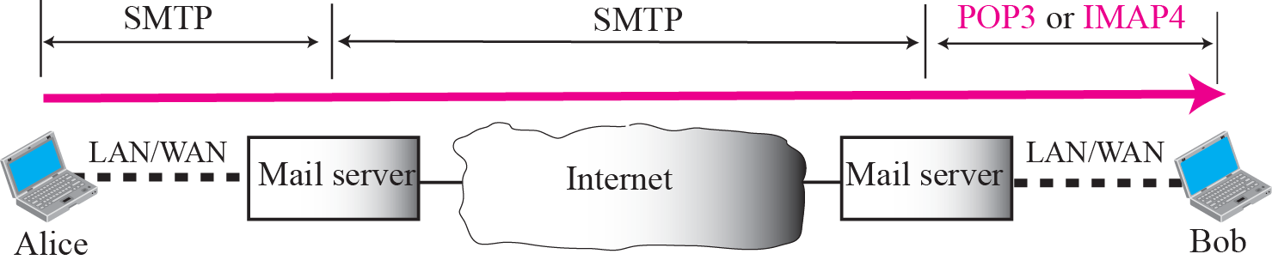
Message access agent
The first and the second stages of mail delivery use SMTP. Here, SMTP is not involved in the third stage because SMTP is a push protocol; it pushes the message from the client to the server.
The third stage needs a pull protocol; the client must pull messages from the server. The direction of the bulk data are from the server to the client.
The third stage uses a message access agent. Currently two message access protocols are available: Post Office Protocol, version 3 (POP3) and Internet Mail Access Protocol, version 4 (IMAP4).

Slide 89
POP3 & IMAP4
POP3(Post Office Protocol, version 3):
The client POP3 software is installed on the recipient computer; the server POP3 software is installed on the mail server. Mail access starts with the client when the user needs to download its e-mail from the mailbox.
The client opens a connection to the server on TCP port. It then sends its user name and password to access the mailbox. The user can then list and retrieve the mail messages, one by one.

Slide 90
POP3 & IMAP4 (Contd..)
IMAP4(Internet Mail Access Protocol, version 4): It is more powerful and more complex.
IMAP4 provides the following extra functions:
A user can check the e-mail header prior to downloading.
A user can search the contents of the e-mail for a specific string of characters prior to downloading.
A user can partially download e-mail. This is especially useful if bandwidth is limited and the e-mail contains multimedia with high bandwidth requirements.
A user can create, delete, or rename mailboxes on the mail server.
A user can create a hierarchy of mailboxes in a folder for e-mail storage.

Slide 91
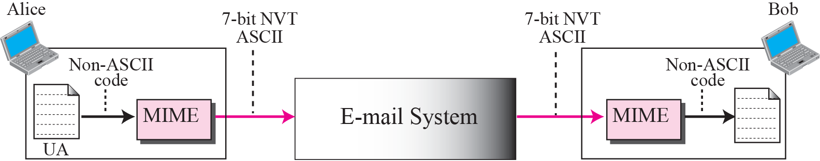
MIME
E - mail has a simple structure. It can send messages only in NVT 7-bit ASCII format. Multipurpose Internet Mail Extensions (MIME) is a supplementary protocol that allows non-ASCII data to be sent through e-mail.
MIME transforms non-ASCII data at the sender site to NVT ASCII data and delivers it to the client MTA to be sent through the Internet.
The message at the receiving site is transformed back to the original data.

Slide 92
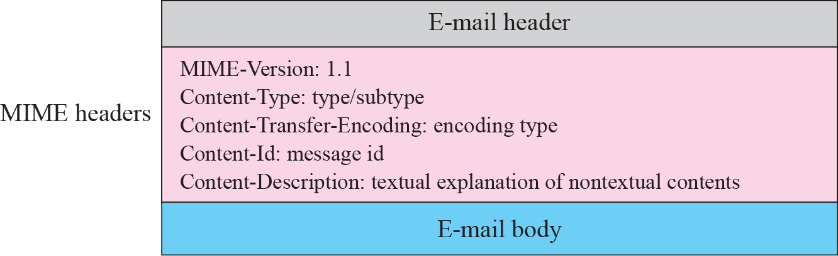
MIME header

Slide 93
MIME header (Contd..)
MIME-Version: This header defines the version of MIME used. The current version is 1.1.
Content-Type :
This header defines the type of data used in the body of the message. The content type and the content subtype are separated by a slash.
Depending on the subtype, the header may contain other parameters.

Slide 94
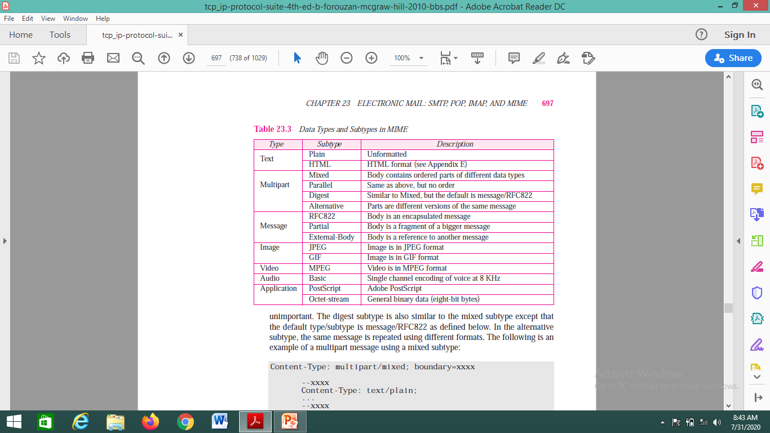
Data Type and Subtype in MIME

Slide 95
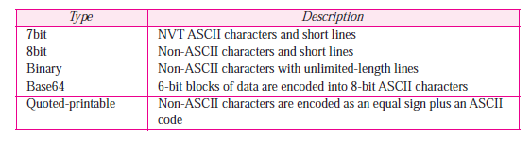
Content Transfer Encoding
Content-Transfer-Encoding: This header defines the method used to encode the messages into 0s and 1s for transport:
The five types of encoding methods are listed

Slide 96
References (finishing slides covering references for all the topics)
Douglas E. Comer, Internetworking with TCP/IP, Principles, protocols, and architecture,Vol 1 5th Edition,2006 ISBN: 0131876716, ISBN: 978-0131876712 (Ref 2 in syllabus)
https://slideplayer.com/slide/13911208/
http://www.csun.edu/~jeffw/Semesters/2006Fall/COMP429/Presentations/Ch25-FTP.pdf
https://study.com/academy/lesson/testing-an-ftp-connection.html
www.afternerd.com/blog/smtp
18CSC302J- School of Computing (Odd sem 2020)

